Slide 1
IRIS Regulatory & Scientific Information Platform
How to register for access to IRIS
Research Product Identifiers: What are they and how do we use them
Online training, 24 September 2020

Slide 2

What we will cover
Provide an overview of IRIS
What is IRIS?
What does it mean for you?
Explain how to register for access and submission via IRIS
Overview of registration process including the following specific topics:
  EMA Account Management Portal
  Organisation Management Service
  Research Product Identifiers (RPIs)
Objectives
Inform where to find guidance and seek support

Slide 3
At the end of this session you will be able to:
Understand registration steps you need to complete in order to access IRIS and submit your application
Understand the purpose of the EMA Account Management portal and how to use it to request or manage user access
Understand the purpose of the Organisation Management Service and how to use it to register an organisation or update organisational data
Understand the concept of Research Product Identifier and how to submit a request to create a new or transfer the existing RPI via IRIS

Slide 4
Overview of IRIS

Slide 5
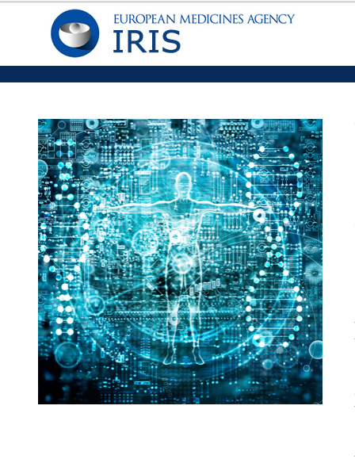
What is IRIS?
IRIS | Regulatory & Scientific Information Management Platform
New Submission Platform (Industry Portal) | Accessed by industry stakeholders | Online web form replaces PDF Application form View of submitted applications Pre-populated Admin data
New Evaluation/ Validation Platform (CRM) | Accessed by EMA staff | Customer Data Management Case Management Manage Interactions
New collaboration tool (Network Portal) | Accessed by regulatory network | Network Portal Simultaneous reviews on documents
New Document Repository (Sharepoint) | Accessed by EMA staff and regulatory network | One secure platform for document sharing and viewing, editing

Slide 6










IRIS uses modern technology to enable business change
Azure Active
Directory
Collaboration
Document Mgmt.
Records Mgmt.
Security
Information Classification
…
Industry Portal,
Network Portal & Public Registers
Customer & Case Management
Knowledge Base
…
IAM
OMS
RMS
EUTCT
(SMS)
PMS
SAP
SIAMED and SCAD

Slide 7

Key benefits for Industry stakeholders
Managing scientific procedures is changing
Same credentials for all applications carried out via IRIS (OD, ITF, SA)
Pre-populated data (e.g. condition and RPI for Protocol Assistance)
More control of your own application
Multi-device access (PC, phone, tablet)
Scientific submissions via web form
User friendly interface
Documents in portal, not sent via e-mail/Eudralink
On-line check of the status of the application
24/7 and real time access
1
2
3
4
5
Single portal
Save time
Better visibility
Better usability
Security
Benefits

Slide 8
Registration Process

Slide 9

How to register for access to IRIS
To access and use IRIS, the platform needs to know:
  Who are you?
  (do I have an EMA account?)
  What organisation do you represent?
  (is my organisation registered in OMS?)
  Which user access role(s) do you have? (what IRIS role do I need to request?)
  This is managed in IAM – EMA Account Management Portal
To complete specific IRIS submissions, there can be additional pre-requisites:
For some* scientific procedures in the orphan designation, ITF and scientific advice domain you also need a valid Research Product Identifier (RPI)​.
Procedures involving a fee require an EMA customer account number (SAP-FIN number)​.
*for other procedures the RPI can be automatically identified by the platform
: IRIS guide to registration
Click here for the next step

Slide 10

Do I have an EMA account?
Please, click on the appropriate button
Yes
No
I don’t know
Click here to go back
Click here for the next step

Slide 11

User registration with EMA
Go to EMA Account Management Portal (IAM)
Create an account
Receive your self-registration confirmation
Click here to go back
Click here for the next step
: IRIS guide to registration Section 3 (EMA user account) and Section 5 (Access to IRIS)

Slide 12

To check if you have an EMA account
Go to EMA Account Management Portal (IAM)
Click on ‘Not sure if you have an EMA account’
Click here to go back
Click here for the next step
: IRIS guide to registration Section 3 (EMA user account)

Slide 13

Is my organisation registered with EMA?
Please, click on the appropriate button
Yes
No
I don’t know
Click here to go back
Click here for the next step

Slide 14

Organisation registration in OMS
If your look-up for an organisation in the EMA Account Management Portal (IAM), IRIS website or SPOR Portal (OMS) came back as negative:
  Login to the OMS portal with your EMA account credentials and create a change request to register it. Registration of a new organisation takes from 5 to 10 working days
If the organisation is found but data is incorrect, login to the OMS portal with your EMA account credentials and create a change request to update it (SPOR user role required)
*you can be affiliated to more than one organisation
Click here to go back
Click here for the next step
: IRIS guide to registration Section 4 and OMS documents page

Slide 15

Look up your organisation
Choose one of the following options:
EMA Account Management Portal (IAM)
Search for your organisation during your user access request process
IRIS portal
Search for your organisation on front-end to the list of organisations and their locations (same data as in OMS/SPOR)
SPOR Portal (OMS)
Search for your organisation in the OMS portal
Click here to go back
Click here to register/update organisation
Click here if your organisation is registered
: IRIS guide to registration Section 4 (Organisation registration in OMS)

Slide 16

User access request to IRIS
Login to the EMA Account Management Portal
Request necessary role and affiliation
  As a first step ensure that at least one person in the organisation you are affiliating with already has an “IRIS Industry User Admin” role, as this person will approve your user access requests (not EMA)
  Only the first request for the “User Admin” role is evaluated and granted by EMA. For this, request the “User Admin” role in EMA Account Management portal and attach the required documentation
  To create, submit, edit and withdraw an application, you need a "Manager" role. The "Contributor" role only allows editing an existing application
  One person can hold both “User Admin” and “Manager” roles
  “IRIS Individual User” role allows to create and submit applications as an individual (not on behalf of an organisation). The system approves this role automatically
Receive notification confirming role approval
Click here to go back
Click here for the next step
: IRIS guide to registration Section 5 (Access to IRIS)

Slide 17
Start using IRIS
After notification that your IRIS user access role has been approved, wait for 30 min to allow time for the synchronisation process
Go to IRIS website and click 'Sign In' and then blue ‘EMA Account’ button
In the Microsoft sign-in window enter your EMA username followed by “@id.ema.europa.eu” (e.g. jones_a@id.ema.europa.eu)
In next window make sure that your EMA Account username is followed by the suffix ‘@id.ema.europa.eu’ and then enter your EMA account password.
You are now ready to use the platform!
If your submission requires a RPI or EMA customer account number click on appropriate buttons for guidance.
Click here to go back
Click here for RPI
Click here for EMA customer account #
Click here to start over
: IRIS guide to registration Section 6
(How to access IRIS after your role has been approved)

Slide 18

Does my RPI appear in the IRIS selection list when creating a submission?*
Please, click on the appropriate button
Yes
No
Click here to go back
Click here for the next step
*Applicable to OD, ITF and SA procedures only

Slide 19
Why can’t I see a RPI for my product?
If a valid Research Product Identifier (RPI) for your research product does not appear on the selection list when creating a draft submission, this may be for one of two reasons:
The RPI already exists but it is not assigned to the organisation on behalf of which you have created the draft submission (or to you if creating an individual submission):
  It could be assigned to another legal entity of your Company, in the same or another country
  It could be assigned to another company
The RPI does not exist yet: request one via IRIS (see next step)
Option | Consequences | Action
Current owner transfers RPI to your organisation (location) | Any new regulatory entitlement / outcome will be granted to your organisation | Submit a “Transfer a research product” request via IRIS
You request affiliation to the RPI owner’s organisation | Any new regulatory entitlement / outcome will be granted to the RPI owner’s organisation | Request to be affiliated with the organisation in IAM
Click here to go back
Click here for the next step
: IRIS guide to registration Section 8 (How to create a request for a “Research Product Identifier”)

Slide 20

Request an RPI
Create a submission for ‘Request for Research Product’ in the IRIS website
  IRIS does not automatically approve your request for an RPI; it is reviewed and approved by the EMA
To do so, the active substance(s) in the product must be already registered in the EMA public list of all substances
In case your ‘active substance’ is not registered
you will need to raise an EMA Service Desk request and attach a completed form to register a new ‘Substance’
  Active substance registration may take up to 5 working days
05
Click here to go back
Click here for the next step
: IRIS guide to registration Section 7 (How to register a new active ‘Substance’ in SMS ), Section 8
(How to create a request for a ‘Research Product Identifier’)

Slide 21

Do I have an EMA customer account number?
Please, click on the appropriate button
Yes
No
Click here to go back
Click here for the next step
*Applicable for procedures where fee is involved

Slide 22

Request a customer account number
(a unique reference number with the Agency for financial matters)
Go to the EMA Invoicing Portal
Click on “Register Now”
Click here to go back
Click here for the next step
: How to pay page on EMA website

Slide 23

Proceed with submission
Click here to go back
Click to start over
Support for IRIS registration queries: EMA Service Desk

Slide 24
EMA Account Management (IAM)

Slide 25






EMA Account Management portal
https://register.ema.europa.eu/identityiq/home.html
Create an EMA account (Self-Register)
Recover your username and password
Re-activate your account
Change your contact details
Request access on behalf of an organisation
Manage users of your organisation

Slide 26

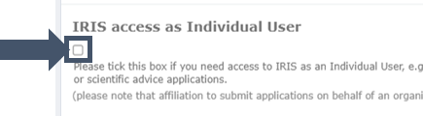
EMA Account Management portal
Create an EMA account (Self-Register)
SPOR, Eudralink, EudraCT Secure, Service Desk portal, European Union telematics controlled terms (EUTCT), Meeting Management System (MMS), Managing Meeting Document system (MMD), EudraVigilance data analysis system (EVDAS), …. full list here
If you have access to any of the following systems, you already have an active EMA account.
If your email is already in user you can retrieve your username with the Forgot Username?
Tick the “IRIS access as Individual Use” checkbox if you need access to IRIS as an Individual User and not on behalf of an organisation to submit, for example, Innovation Task Force (ITF) meeting requests, orphan or scientific advice applications.
https://register.ema.europa.eu/identityiq/help/selfregister.html

Slide 27
EMA Account Management portal
Recover your username and password
Re-activate your account
To recover your username click on the "Forgot Username?" link and you will receive an email with your username.
To reset your password click on the "Forgot Password?" link and follow the instructions.
Note: Check your spam e-mail folder if you have not received the one-time token required to reset your password.
All EMA accounts are automatically disabled after 6 months of inactivity. Prior to disabling the account, the system sends three reminders to the user (two weeks, one week and one day before the account is disabled).
To re-activate your account you will need to use the "Forgot Password?" process. By re-setting your password your account will be re-activated and a notification sent to your email address. If you are affiliated to an organisation, your 'User Administrator' will also be notified that your account has been re-activated.
https://register.ema.europa.eu/identityiq/help/recover.html

Slide 28
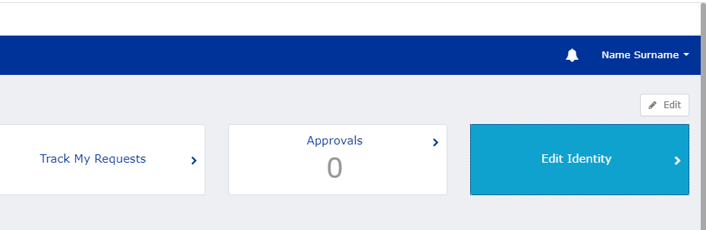
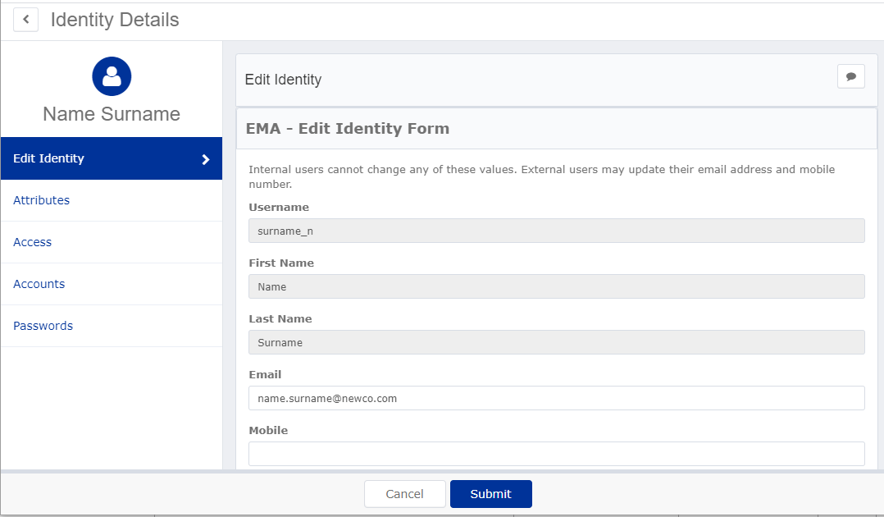
EMA Account Management portal
Change your contact details
To update your name or any other details submit a request via EMA Service Desk.
You can change your contact details such as email address and mobile number by logging into the portal and making these changes in the "Edit Identity" area.

Slide 29





EMA Account Management portal
Request access on behalf of an organisation
4. EMA Approves / Rejects
EMA
1. Look for the role IRIS/PD User admin
5. Decision notified
8. IRIS/PD User Admin Approves/Rejects
Usr Adm
2. Attach signed “Affiliation Template Letter”
3. Select the organisation
Usr
6. Look for the role IRIS/PD Manager/Contributor
7. Select the organisation
9. Decision notified

Slide 30

EMA Account Management portal
Request access on behalf of an organisation
For the first user admin the requester’s e-mail should preferably be a work e-mail from the same organisation on behalf of which the user is requesting the user access. The EMA will refuse requests coming from Gmail, Yahoo and similar private addresses.
We recommend to have more than one User Admin to increase resiliency, all the requests to access in behalf of the organisation can be approved by any of the user admin
Third party providers (Consultants)
Consultants can access in behalf of several organisation. Based on the policy defined by the organization they can use a work email provided by the organisation (e.g. john@pharma.com) or the work email of the consultancy (e.g. john@kinapse.com).
Consultancy can request User Admin role by providing an additional letter stating that the organisation authorises this person to have the User Admin role in their behalf.
https://register.ema.europa.eu/identityiq/help/requestaccess.html

Slide 31
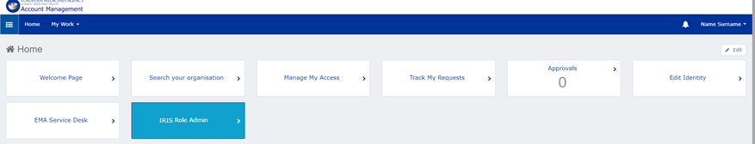
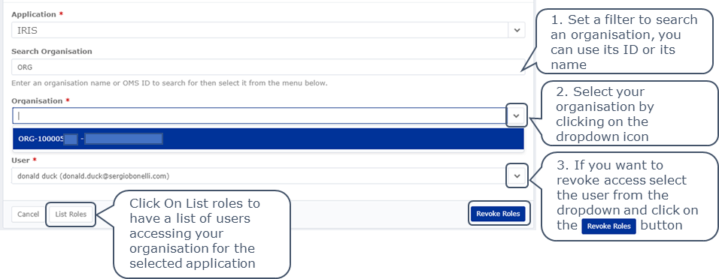
EMA Account Management portal
Manage users of your organisation
A ‘User Administrator’ of an organisation is responsible for approving and revoking access for users of the same organisation.
They are also notified when users accounts are reactivated or when the email address of a user has changed.
To list and revoke access use the “IRIS Role Admin” functionality
https://register.ema.europa.eu/identityiq/help/useradmin.html

Slide 32
Organisation Management Service (OMS)

Slide 33
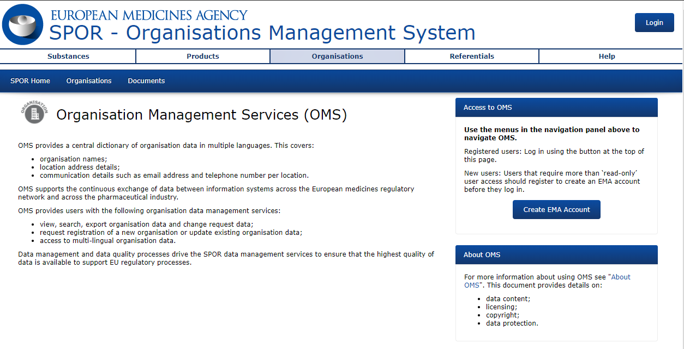
Organisation Management Service (OMS)
Create new organisations/locations
Updates organisations/locations
Export all information
Documentation
  User Registration - information
  on roles
  Web User manual – guidance on
  how to create change request
https://spor.ema.europa.eu/omswi/#/

Slide 34
Organisation Management Service (OMS)
Roles and permissions
Unaffiliated
Create organisations - limited to 1 pending request at a time
SPOR Industry Super User
Create/Update organisation and location data
Guest
View content
SPOR Industry User
Create/Update organisation and location data
Export information
Export information
Export information
Manage users
Everyone
Automatic with creation EMA account
Per request in EMA Account Management
Per request in EMA Account Management
For the first Super User the requester’s e-mail should be a work e-mail from the same organisation on behalf of which the user is requesting the user access

Slide 35
Organisation Management Service (OMS)
OMS is a standardised list of Organisations/addresses
OMS reflects equivalent information as the Trade registry (or other documents/sources) but it is not meant to be the same/“copy” of Trade registry (or other documents/sources)
OMS uses Reference sources of information (Trade registry, DUNS, other documents/sources) to ensure data correctness/accuracy
OMS should reflect consistent information i.e. OMS will apply/standardise the Organisation/address information according to the agreed data quality rules
OMS should reflect correct* Organisation/legal entity, correct* relationship with its address, the correct* address *data that reflects reality

Slide 36


Organisation Management Service (OMS)
CR process at a glance
1. Submission
2. Validation
3. Approval/ Rejection
Requestor
EMA Data Stewards
Guidance/references & tools
EMA Data Stewards
OMS DQ standard
Business register
AddressDoctor validation service
5 – 10 Working day SLA
OMS CR approved = data published/updated in the OMS dictionary
-----
OMS CR rejected = reasons explained to requestor via email
If disagreement, raise ticket in Service Desk, identifying the relevant CR number
Submit OMS CR:
- Add Organisation
- Update Organisation
- Add Location
- Update Location
- Update Organisation & Location
Include supporting document. This can vary from business registry documentation, to DUNS registration or to the GXP certificate
Data Stewards validate all OMS CRs using guidance/references & tools:
OMS DQ standard, as guidance - it describes the business rules/approach for mastering organisations
Business register – used to confirm that the supporting documentation is valid and still current
AddressDoctor:
  Used as validation service to check, standardise or enrich address data in English and in local languages
  Has reference files for more than 240 countries and territories around the globe
  Addresses are formatted according to local postal standards

Slide 37
Research Product Identifier

Slide 38
Research Product Identifier (RPI)
What is an RPI?
An RPI identifies a development concept, usually a potential new medicinal product or an already authorised one.
However, RPIs can also be used to identify methodologies, technologies, or multiple medicinal products/substances of the same class
(e.g. for Innovation Task Force briefing meetings, Scientific Advice / qualification procedures)
RPIs are used at EMA to connect submissions, procedures and regulatory entitlements for the same development entity.

Slide 39
Research Product Identifier (RPI)
RPI principles:
If a development product is transferred to another developer, the RPI remains the same.
A centrally authorised product is always associated to an RPI in IRIS:
    Generic, hybrid or biosimilar products from different applicants have different RPIs;
    An orphan and a non-orphan authorisation products from the same applicant and containing the same substance(s) are associated to a single RPI (e.g. Sildenafil/Pfizer: Revatio, Viagra. 1 RPI).
The same research product from the same developer needs separate RPIs for human and veterinary development.
A human RPI can only include SMS human domain substance(s).
(automated validation in IRIS)

Slide 40
Research Product Identifier (RPI)
How does an RPI relate to scientific applications?
An RPI is needed for every scientific submission regarding a product or development (e.g., Orphan designations, ITF, Scientific Advice, etc.)
Some submissions are based on a previously obtained regulatory entitlement (e.g. orphan designation, Scientific Advice letter, etc.)
→ in this case the RPI is automatically obtained from the existing entitlement.
Avoid requesting a new RPI if the product already has one.
E.g. all products with an orphan designation and all centrally authorised products are already associated to an existing RPI.

Slide 41
How to request an RPI
create a “Request for Research Product” submission in IRIS.
If your RPI is not for a single medicinal product, but for a group of products or technology or methodology, the standard process does not apply. You need to seek assistance in obtaining an RPI by referring to Innovation in medicines (for ITF) and Requesting scientific advice or protocol assistance from EMA (for SA).
Notes on active substances
Any active substance(s) for the RPI must be already included in SMS, and available in IRIS here: EMA public list of all substances
In case your ‘active substance’ is not in the list above → request registration (currently via an EMA Service Desk request and a completed form to register a new ‘Substance’ – new procedure being developed)
Active substance registration may take up to 5 working days
Veterinary substances in SMS (and IRIS) are in need of a cleanup exercise

Slide 42
Research Product Identifier (RPI)
You know that an RPI already exists, but you cannot find it:
Case A: the RPI is assigned to another organisation:
There are two possibilities:
Case B: the RPI is not assigned to any organisation: (e.g. old UPIs transformed into RPIs)
You need to contact EMA via ServiceDesk so that the RPI is reassigned by EMA staff to the correct organisation / location.
DEMO OF RPI REQUEST IN IRIS
Options | How | Consequences
Transfer RPI (current owner transfers to new owner) | Current owner can do this directly in IRIS | Any new regulatory entitlement / outcome will be granted to the new owner
Request affiliation to existing owner of the RPI | IRIS user requests affiliation to existing owner in the the EMA Account Management Portal. | Any new regulatory entitlement / outcome will be granted to the current (existing) owner

Slide 43

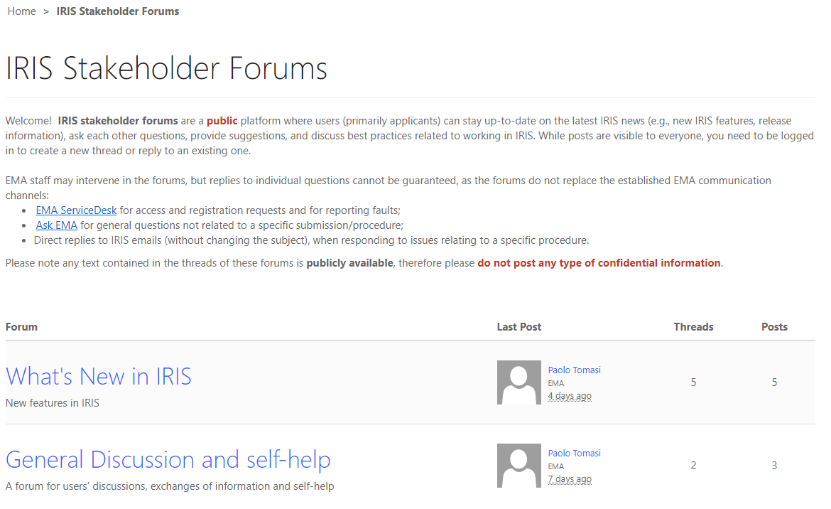
Guidance documents
If you remember nothing else, remember this…
Read the guidance which is available on the IRIS portal homepage (https://iris.ema.europa.eu/):
Quick interactive guide to IRIS registration process
IRIS guide to registration
Visit IRIS Forums (https://iris.ema.europa.eu/forums/)
(‘What’s new in IRIS’ and users’ self-help)
If you cannot find the support you need in the IRIS guidance documents or via IRIS Forums then
Contact the EMA Service Desk (https://servicedesk.ema.europa.eu/)for technical queries

Slide 44
Thank you!
Further broadcast training sessions
(no registration required):
How to submit an Initial and Follow-up Scientific Advice (human) applications in IRIS - 13 October 2020
How to submit an Initial and Follow-up Scientific Advice (veterinary) applications in IRIS - 14 October 2020

